Slide 1

HANDS-ON WITH REACT
Context

Slide 2
React Context
We can pass values to child components via props. However, things can become difficult to manage when you start passing props down multiple nested layers. This is known as “prop drilling”.
A React feature called “Context” is one way to solve this. Context lets you pass data deep down layers of components.
Let’s use an example to demonstrate this concept.

Slide 3
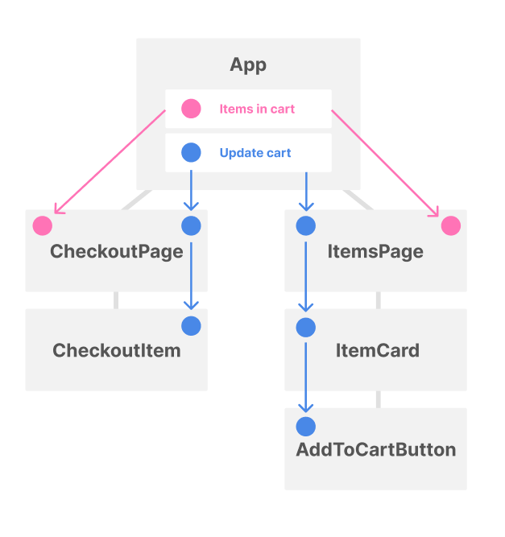

Without Context
In this example, we have a shop app that stores items in the user’s shopping cart.
Deep components such as AddToCartButton need to be able to update the cart, which means the functionality needs to be manually passed through multiple layers of components via props.
Also, the functionality is passed through components that don’t care about it, such as ItemsPage.
Pros
Simple to implement
Cons
Clunky if your app has deeply
nested components that require data from above

Slide 4
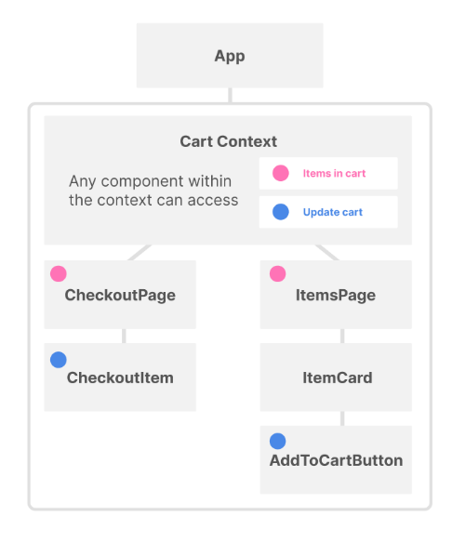
With Context
With Context, we no longer need to pass data through many layers of components. Context lets us send values to components far down the tree.
A context can hold whatever values or functions you want. Any component within the context has access to these values.
AddToCartButton now has easy access to the update cart functionality because it is inside the cart context.
Pros
Eliminates need for prop drilling
More maintainable
Cons
Takes a few more steps to get set up
Can cause unwanted re-renders
Notes:
Explain “Can cause unwanted re-renders”
- Whenever the value of a context changes, *every* component that uses that context will re-render - even if it doesn’t care about the value that changed. Re-rendering lots of components may cause performance issues. However, if there are performance issues, that does not necessarily mean Context is the problem – it could be the way that the developer has implemented Context.

Slide 5
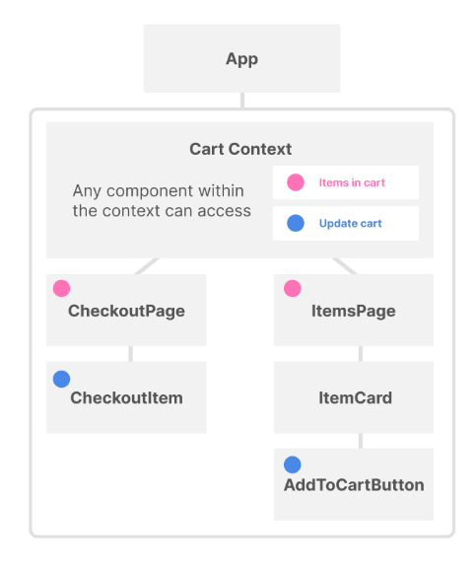
Before and after

Slide 6
React Context
Now that we’ve looked at why Context is useful and what it can do, let’s see this in practice.

Slide 7

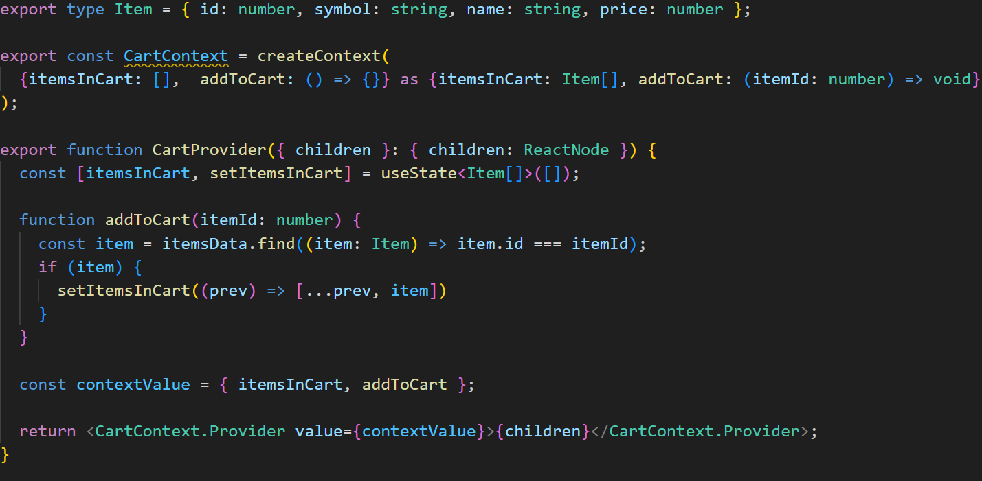
React Context
We need to make sure we have imported createContext from react
We create a context that can be passed to the children.

Slide 8
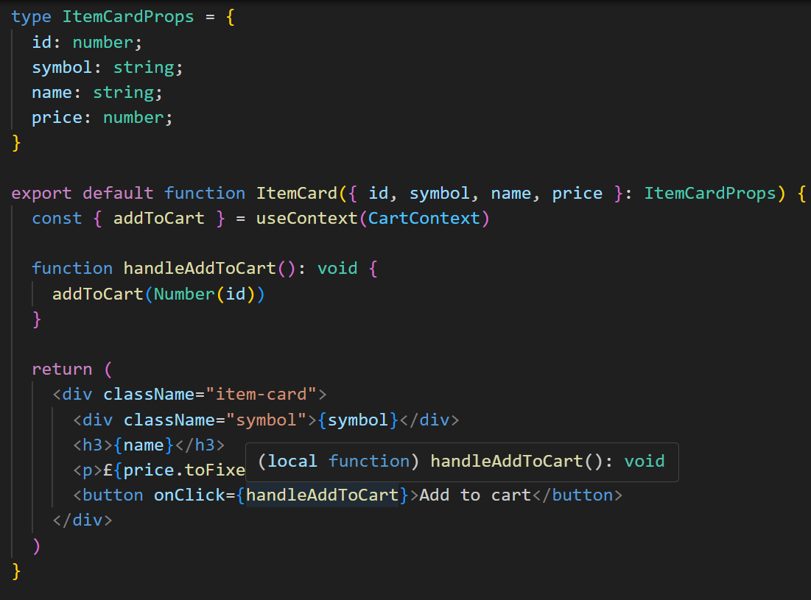
React Context
In the Item Cart, we import the context created and ensure we have imported the useContext hook.
When the call to action button is clicked, the addToCart context is accessed and run like a normal function call

Slide 9
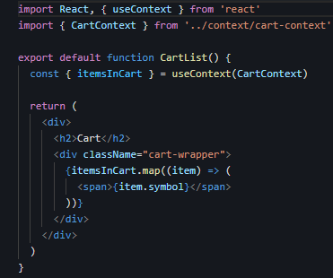
React Context
This updates the Cartlist items which re-renders in the DOM

Slide 10
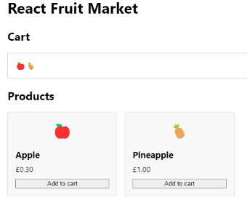
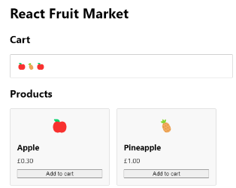
React Context
Updating the cart after every click using the context.

Slide 11
Quick Lab 13
Context

Slide 12
CAVEAT
We just saw how Context can aid in managing state in your application.
Many state management libraries also exist to solve the problem of managing application state.
Many real-world applications utilise these libraries, because they solve a lot of problems, such as:
Providing centralised, global state
Tracing state (useful for debugging)
Decoupling state logic from the UI (useful for testing)
Some examples of state management libraries are Redux Toolkit and Mobx.
We don’t cover these in this module, but it’s worth being aware that they exist because they are so commonly used.

Slide 13
HANDS-ON PROJECT
At your own pace, work through
Challenge 1
Challenge 2
Challenge 3
Challenge 4
Extensions

Slide 14
That’s a wrap!

